Slide 1
Network Security Technology
By Michael Chillemi

Slide 2
What is Network Security
The policies, techniques, and practices used to prevent, detect, and monitor unauthorized access, misuse, modification, or denial of a computer network and network-accessible resources are referred to as network security.
Protecting client data and information, keeping shared data secure, guaranteeing reliable access and network performance, and protecting against cyber attacks all require network security. A well-designed network security solution lowers operating costs and protects businesses from severe losses caused by data breaches or other security incidents. Having legitimate access to systems, apps, and data allows businesses to run smoothly and provide services and goods to customers.

Slide 3

Encryption
The process of encryption or encoding data and messages exchanged or communicated across a computer network is known as network encryption. It's a comprehensive procedure that entails a variety of tools, strategies, and standards to ensure that messages are unreadable while being sent between two or more network nodes.

Slide 4
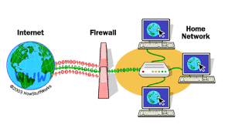
Firewalls
A firewall is a network security device that analyzes incoming and outgoing network traffic and determines whether specific traffic should be allowed or blocked based on a set of security rules.
For more than 25 years, firewalls have served as the first line of defense in network security. They create a barrier between secure, controlled internal networks that can be trusted and untrusted external networks like the Internet.
A firewall might be hardware, software, or a combination of the two.

Slide 5
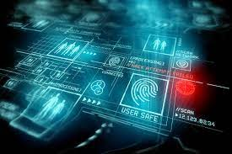

Biometrics
Biometric security is quickly becoming the preferred method of protecting businesses and individuals from hackers looking to commit fraud and identity theft. Individuals must be aware that biometric data such as fingerprints or face recognition can be 'hacked,' as cyber criminals attempt to steal or 'spoof' biometric data.
Ex:
Voice Recognition
Fingerprint Scanning
Face Recognition
Iris Recognition

Slide 6
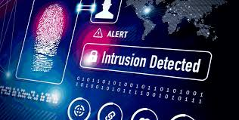
IDS
An Intrusion Detection System (IDS) is a network security device that was designed to discover vulnerabilities in a target application or machine. Intrusion Prevention Systems (IPS) expanded IDS solutions by allowing them to prevent threats in addition to detecting them, and they have since become the most popular IDS/IPS deployment option.
Top Intrusion Detection Systems
-Bro
-OSSEC
-Snort

Slide 7
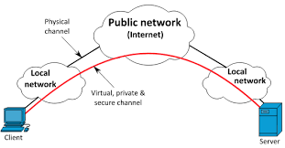
VPN
A virtual private network (VPN) creates a secure connection between you and the internet. All of your data traffic is routed over an encrypted virtual tunnel via the VPN. When you access the internet, this masks your IP address, making its location invisible to everyone. External attacks are also protected by a VPN connection.

Slide 8
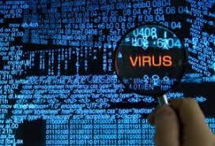
Types of Attacks
Virus- A virus is a harmful, downloaded file that can lie dormant and reproduce itself by replacing the code of other computer programs with its own.
Worms- Can slow down computer networks by using bandwidth and decreasing your machine's ability to process data.
Trojan- A trojan is a backdoor application that allows malicious people to gain access to a computer system by imitating a legitimate program but swiftly revealing itself to be dangerous.
Spyware- Much like its name, spyware is a computer virus that gathers information about a person or organization without their express knowledge and may send the information gathered to a third party without the consumer’s consent.
Adware- Can send your search requests to advertising websites and collect marketing data about you in the process, allowing you to see customized ads based on your search and purchasing history.
Ranware- This is a sort of trojan cyberware that encrypts data and blocks access to the user's system in order to steal money from the person or organization whose computer it is placed on.

Slide 9
Sources
https://www.checkpoint.com/cyber-hub/network-security/what-is-network-security/
https://www.lifewire.com/introduction-to-network-encryption-817993
https://www.cisco.com/c/en/us/products/security/firewalls/what-is-a-firewall.html
https://www.cnahardy.com/news-and-insight/insights/english/cyber-securit-the-future-risk-of-biometric-data-theft
https://www.paloaltonetworks.com/cyberpedia/what-is-an-intrusion-detection-system-ids
https://www.open.edu/openlearn/science-maths-technology/computing-and-ict/systems-computer/network-security/content-section-4.1
https://www.softwaretestinghelp.com/intrusion-detection-systems/
https://www.kaspersky.com/resource-center/definitions/what-is-a-vpn

Slide 10
Thank You!

